Slide 1

ECE 593 Fundamentals of Pre-Silicon Validation Design and Verification of Asynchronous FIFO Team 1
Bhargav Chunduri - bhargavc@pdx.edu
Dhushyanth Dharmavarapu – dharmava@pdx.edu
Venkata Krishna Kumar vedantam – vedantam@pdx.edu

Slide 2

Agenda
Introductions of Team Memeber
Overview of the Project
Design Implementation
Class based Verification
UVM based Verification
Key Challenges and Lessons Learned
Project Demonstration
Q&A Session

Slide 3
Introduction of Team Members
Bhargav Chunduri
Dhushyanth Dharmavarapu
Venkata Krishna Kumar vedantam

Slide 4

Project Overview
An asynchronous FIFO acts as an intermediary buffer to facilitate data transfer between two distinct clock domains in a digital system.
It plays a vital role in enabling reliable and efficient data transfer in asynchronous systems, especially when data is exchanged between domains operating at different clock speeds.
These FIFOs are essential for ensuring smooth and organized data flow in digital systems operating across asynchronous clock domains.
Write and Read Conditions: • Writing: After every write operation, Sender waits 2 clock cycles before writing the next data. This means data is written once every 3 clock cycles. •
Reading: After each read operation, Reciver waits 1 clock cycle before reading the next data. This means data is read once every 2 clock cycles.
Specifications
Producer clock1 frequency = 500 MHz
Consumer clock2 frequency = 225 MHz
Burst Length = 1024
With duty-cycle of 50%
Minimum FIFO Depth = 342

Slide 5

Design Implementation
An extra bit is used to determine FULL and EMPTY status.
Gray coding is applied to safely synchronize pointers across different clock domains, with the MSB being compared to detect these conditions.
During reset, both the write and read pointers are initialized to zero.
After data is written to the current memory location, the write pointer is incremented to point to the next location.
Full & Empty Conditions
The FIFO is considered empty when the read and write pointers are equal, which occurs either after a reset or when the read pointer catches up to the write pointer.
The FIFO is considered full when the pointers are once again equal, which happens when the write pointer wraps around and reaches the read pointer.

Slide 6
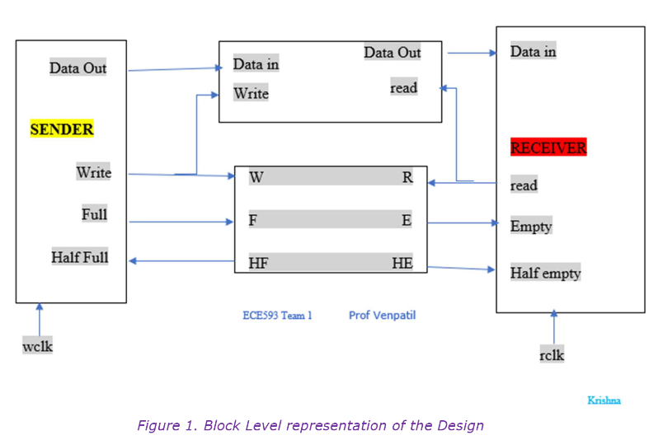
Block Diagram of Asynchronous FIFO

Slide 7
Verfication of Aysnchorous FIFO
Our Verification of Aysnchorous FIFO is done with both:
System Verilog Verification Environment
UVM based Verification Environment

Slide 8
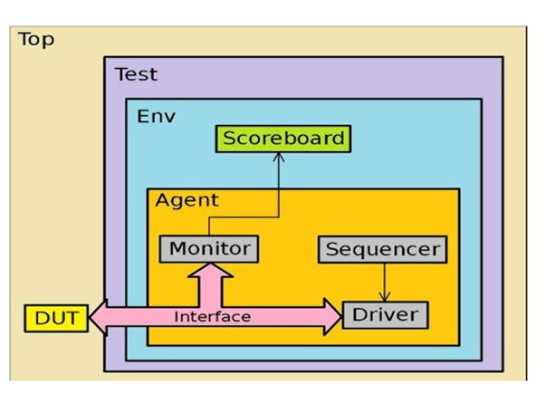
SystemVerilog Verification Environment

Slide 9
Class Based Verification
Verification includes the development of a testbench using components built with SystemVerilog classes.
The key classes involved are:
Transaction
Generator
Driver
Monitor
Scoreboard
Instances of these classes are created within the "Environment" class.
The overall process flow is shown in the following slide.

Slide 10
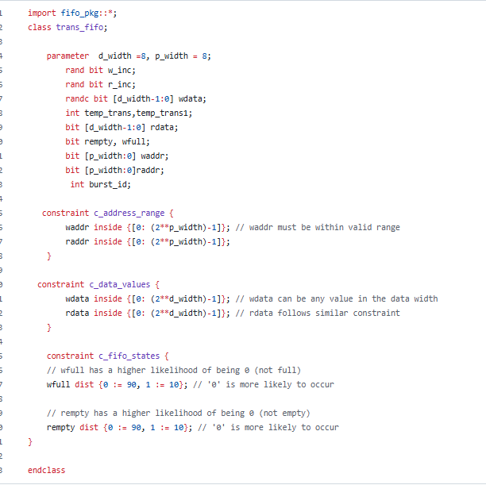
SV Test Bench Components
Transaction
Defines the pin level activity generated by agent (to drive to DUT through the driver) or the activity has to be observed by agent (Placeholder for the activity monitored by the monitor on DUT signals)

Slide 11
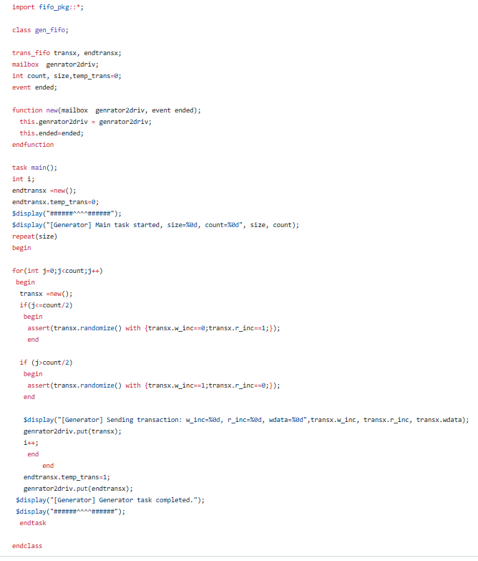
Generator
Generates the stimulus (create and randomize the transaction class) and send it to Driver

Slide 12
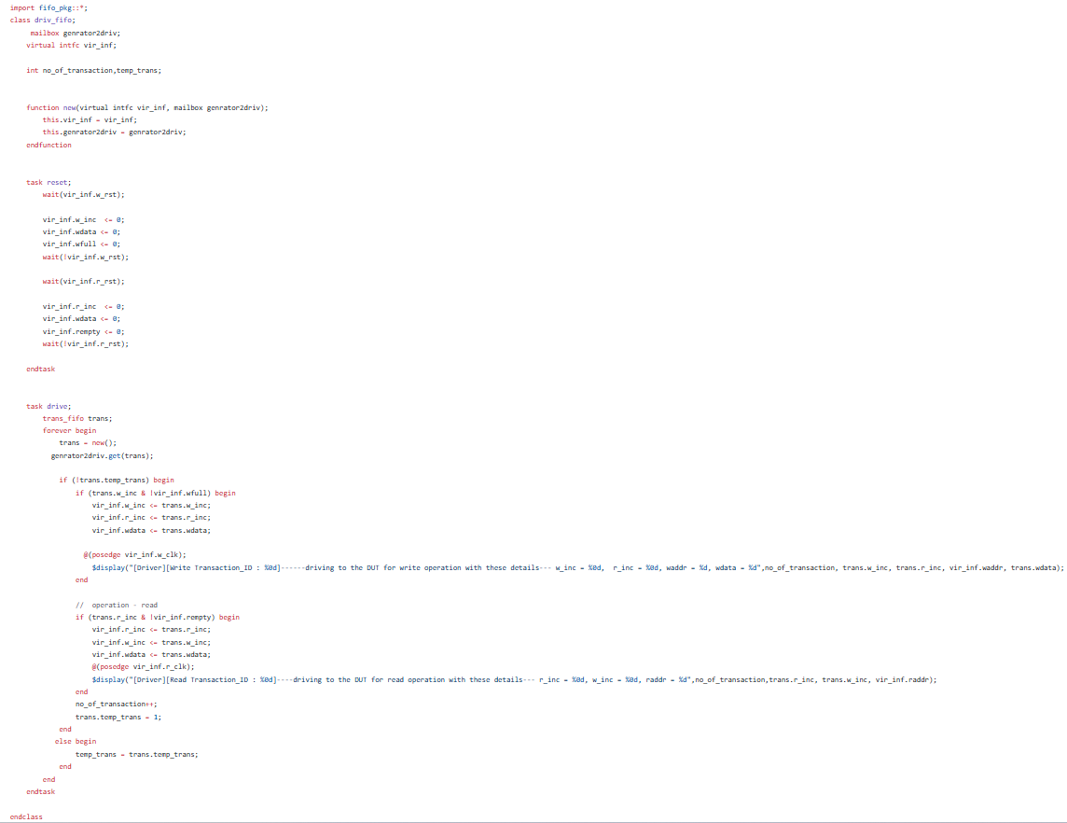
Driver
Receives the stimulus (transaction) from a generator and drives the packet level data inside the transaction into pin level

Slide 13
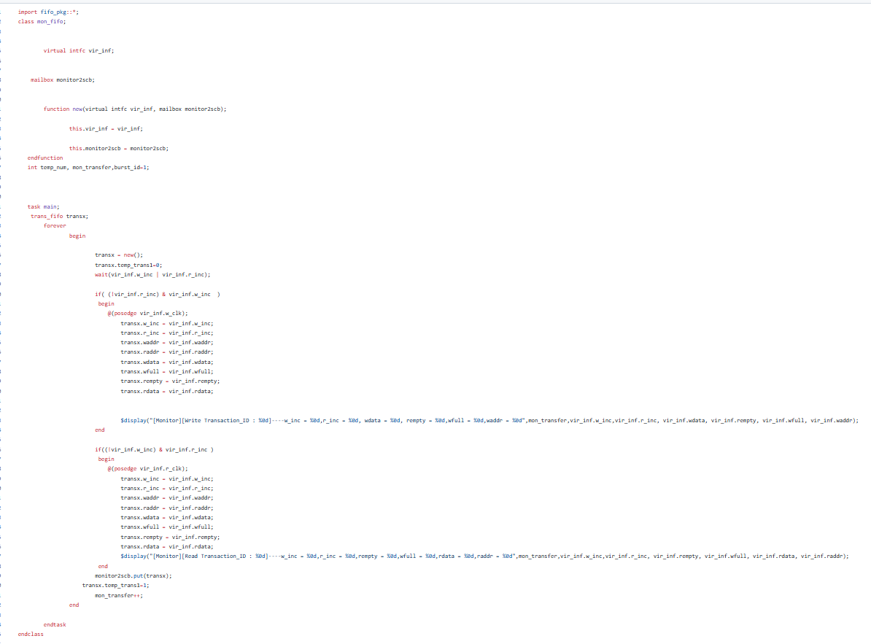
Monitor
Observes pin level activity on interface signals and converts into packet level which is sent to the components such as scoreboard

Slide 14
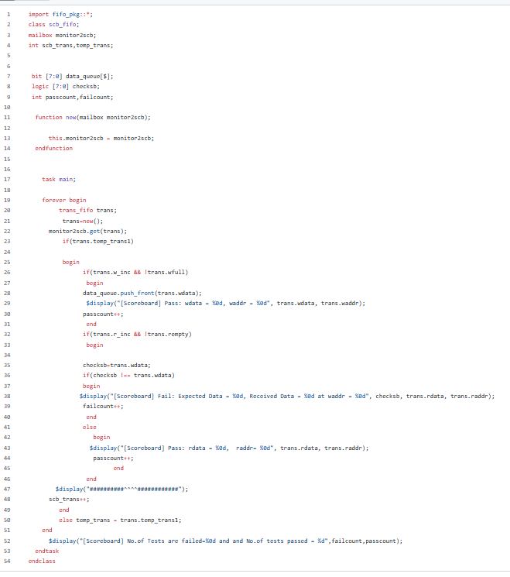
Scoreboard
Receives data items from monitors and compares them with expected values. Expected values can be either golden reference values or generated from the reference model

Slide 15
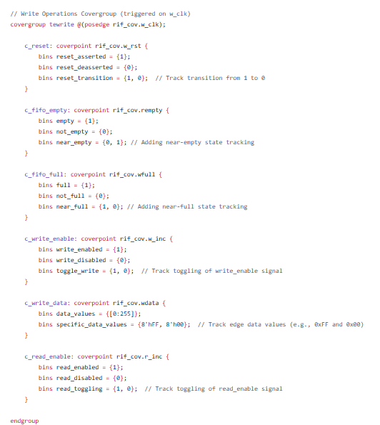
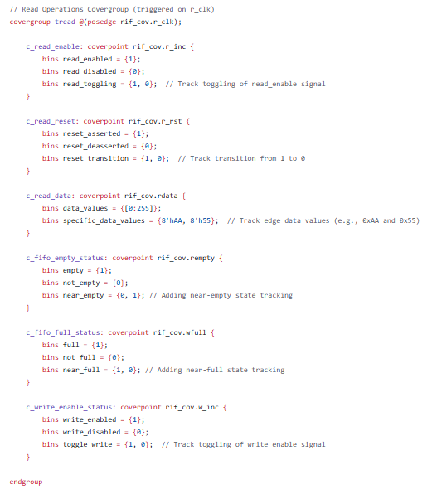
Coverage
Coverage refers to the process of measuring how much of your design or verification environment has been exercised by your tests. It is an important metric to determine the completeness and quality of your verification process.

Slide 16
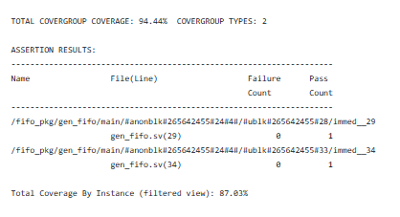
After Simulation our Coverage Percentage …

Slide 17
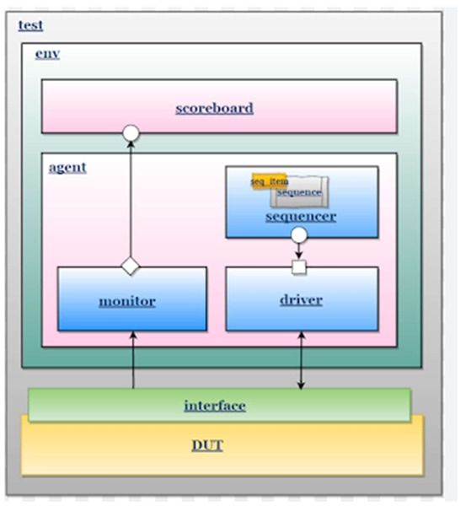
UVM based Verification
The Universal Verification Methodology (UVM) provides a standardized approach for verification, focusing on the creation of reusable verification components and environments. The following outlines the verification process using UVM.

Slide 18
UVM Based Verification
Verification includes the development of a testbench using components built with UVM.
The key classes involved are:
uvm_seq_item
Uvm_sequence
Uvm_sequencer
Uvm_driver
Uvm_monitor
Uvm_scoreboard
Instances of these classes are created within the “uvm_env" class.
The overall process flow is shown in the following slide.

Slide 19
UVM-Based Verification Process
Defining UVM Components:
Agents: Comprise the driver, monitor, and sequencer for a specific interface.
Environment: Includes multiple agents along with additional verification components.
Sequences and Sequence Items: Define the transactions and their execution order.
Scoreboard: Verifies the correctness of the DUT by comparing the expected and actual results.
Creating the UVM Testbench:
Instantiate the DUT and connect it to the UVM environment via virtual interfaces.
Configure UVM components using uvm_config_db.
Writing Tests:
Develop tests to set up and execute various sequences on the DUT.
Running Simulations and Analyzing Results:
Run simulations using UVM runtime phases.
Analyze coverage and functional results to ensure thorough verification.

Slide 20

UVM-Based Verification Process
Writing Test Sequences:
Sequence Class: Defines a sequence of transactions to be executed on the DUT. These sequences can be randomized to explore different scenarios.
Connecting Components:
Components like the driver, monitor, and scoreboard are linked via TLM (Transaction-Level Modeling) ports and exports, allowing for seamless transaction communication between them.
Running Simulations:
Simulations are performed using the testbench, and the results are analyzed to ensure the DUT functions correctly under various conditions.

Slide 21
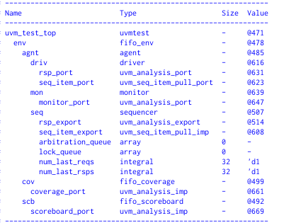
UVM Environment we build..
Topology of our UVM environment

Slide 22
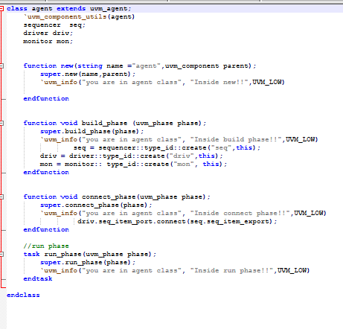
UVM TestBench Components
Agent
It generally consists of a driver, monitor, and sequencer. During the build phase, the `create` method for the sequencer, driver, and monitor is implemented using factory registration methods from the `uvm_object` class

Slide 23
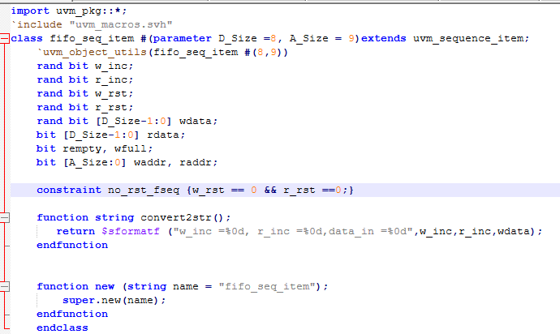
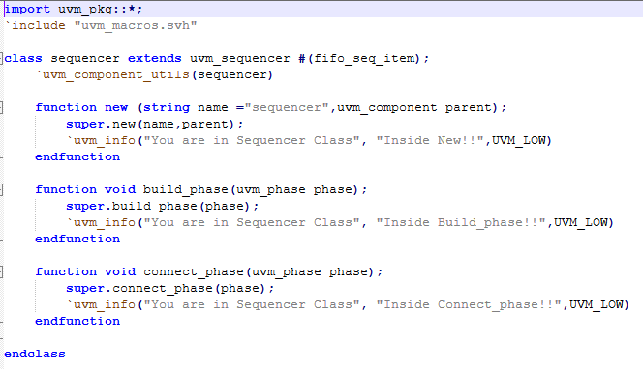
Sequence Item
In UVM, the Sequence is responsible for randomizing all inputs, which are then passed through the sequencer to the driver.
During this process, constraints are applied to the read enable and write enable signals.
Sequencer
The sequencer handles the creation and ordering of stimulus transactions.
In UVM, the build and connect phases are used within the sequencer to establish a connection with the driver and transfer items from the sequencer to the driver.

Slide 24
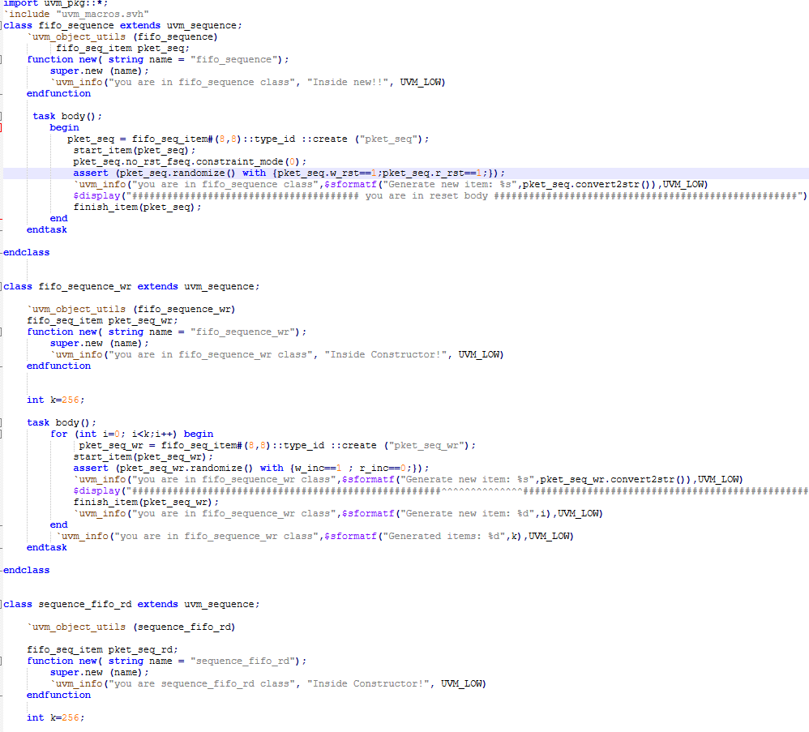
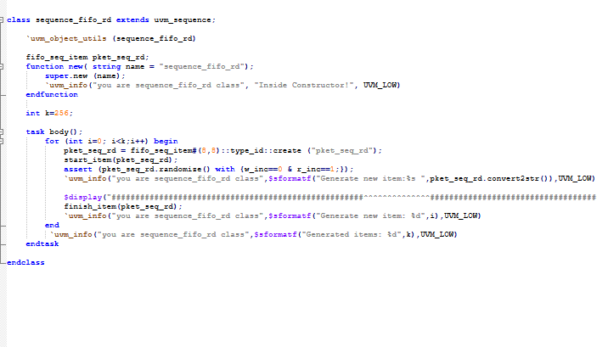
Sequence
UVM sequences are made up of several data items which can be put together in different ways to create interesting scenarios. They are executed by an assigned sequencer which then sends data items to the driver. Hence, sequences make up the core stimuli of any verification plan.

Slide 25
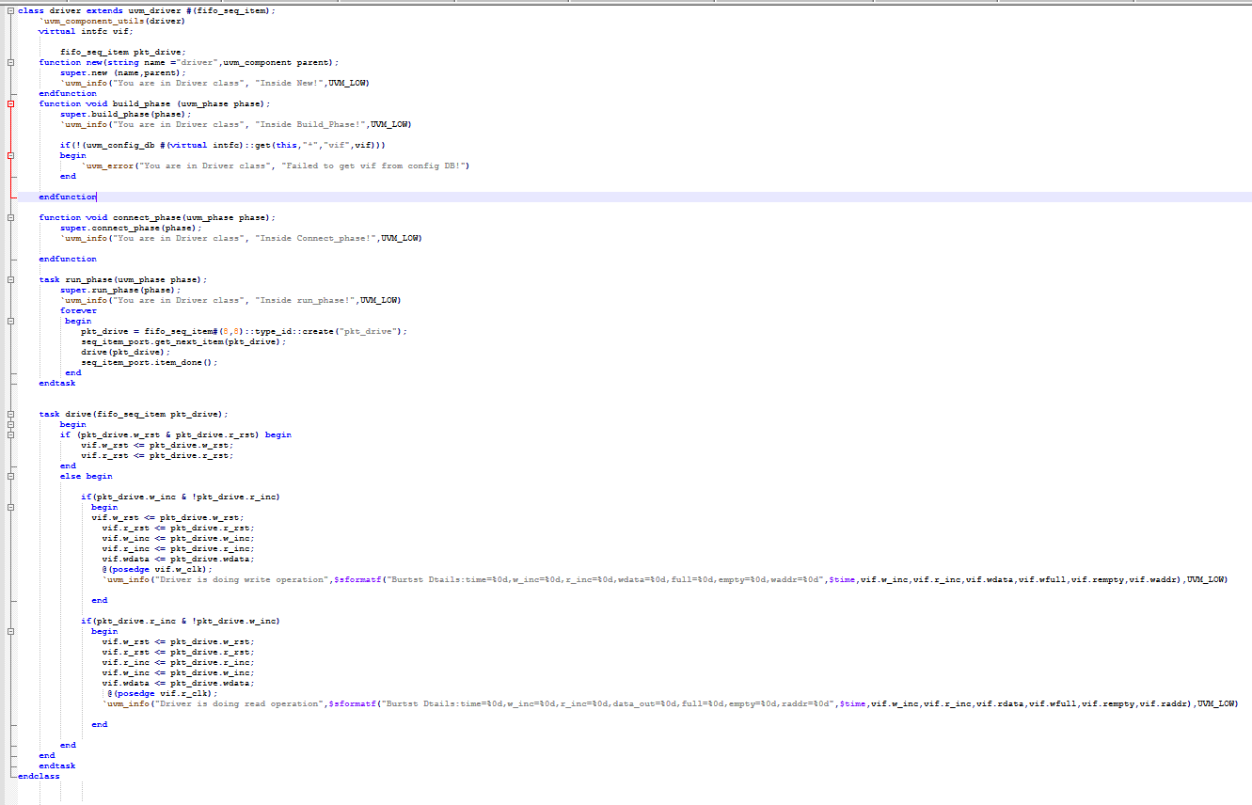
UVM TestBench Components
Driver
The driver is responsible for converting the transaction-level stimulus generated by the sequencer into signals and driving the actual interface. The Build Phase, Connect Phase, and Run Phase facilitate establishing connections and executing various operations.
.

Slide 26
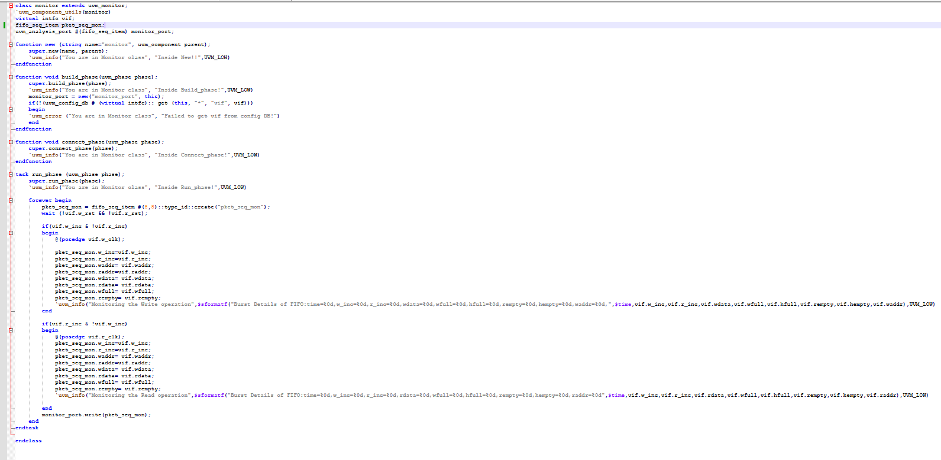
Monitor
The monitor continuously gathers input and output data from the DUT and transmits it to the scoreboard.
During the Build Phase, it establishes the correct connection to the interface using uvm_config_db.

Slide 27
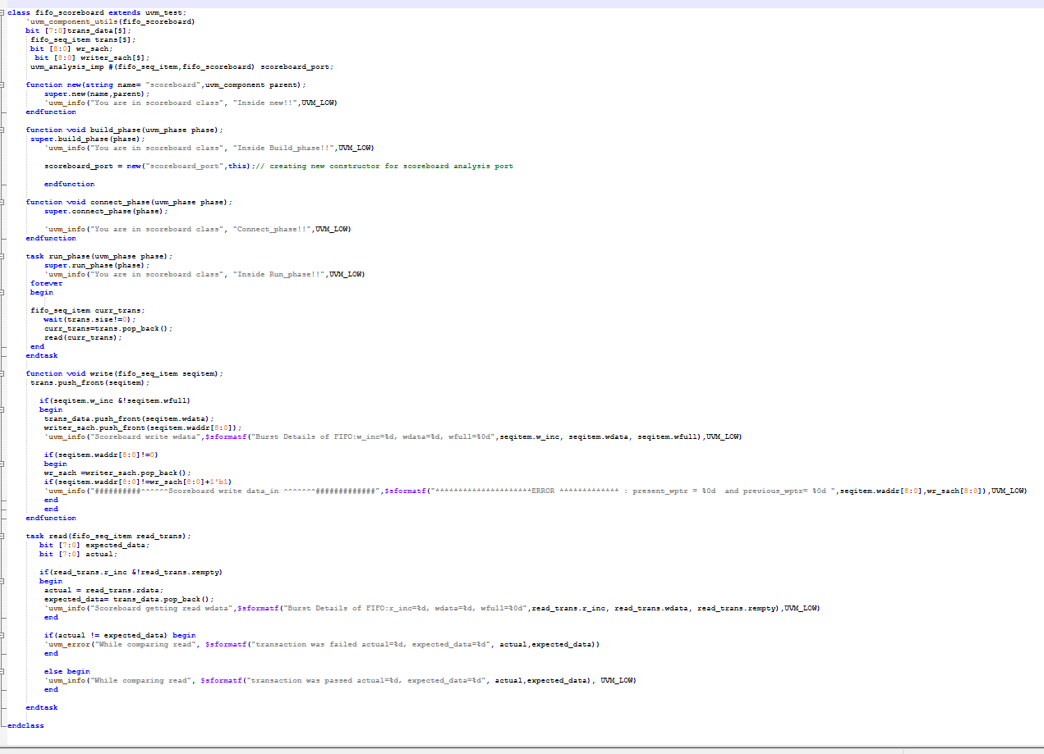
Scoreboard
A write method is employed to insert values into the queue, while a task read method extracts values from the reference queue and compares them with the actual `data_out`.
The scoreboard contains an analysis port that links to various components within the UVM testbench hierarchy.

Slide 28
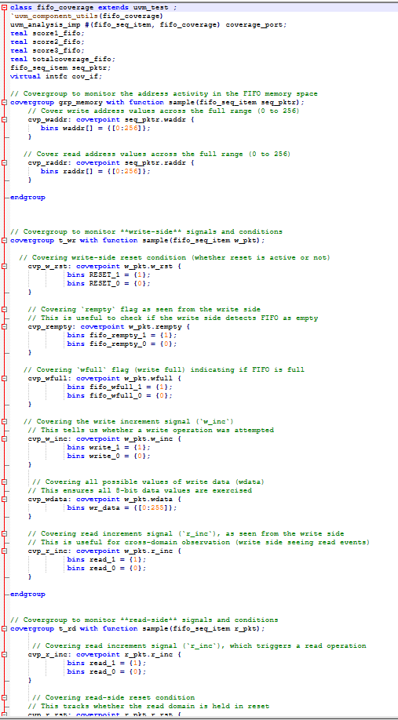
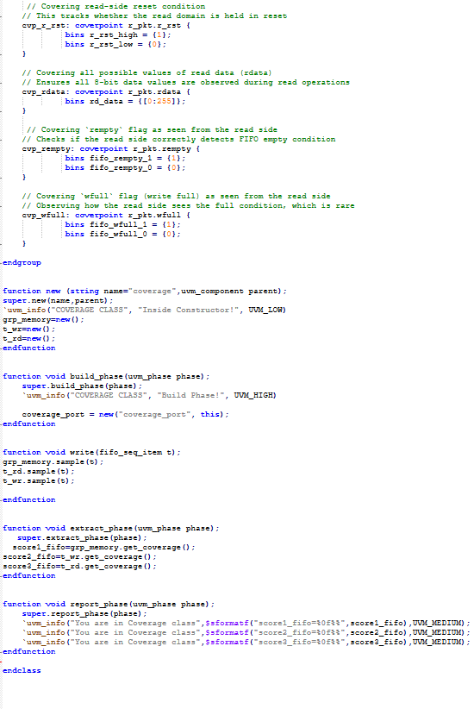
Coverage
Coverage refers to the process of measuring how much of your design or verification environment has been exercised by your tests. It is an important metric to determine the completeness and quality of your verification process.

Slide 29
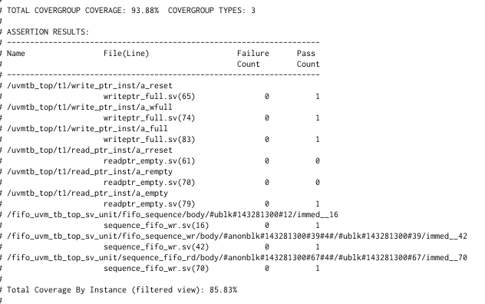
After Simulation, Coverage Precentage…

Slide 30

Key Challenges
Debugging in UVM proved to be challenging, especially due to the layered structure and complex interactions.
The `data_out` was not updated correctly after each read transfer in the monitor and driver.
Managing configurations and ensuring proper setups for different tests demanded careful attention.
Race conditions between the write and read pointers were also a concern.

Slide 31
Lessons Learned
1. Standardization and Reusability:
UVM offers a standardized framework that promotes the reuse of verification components across various projects.
2. Modularity:
With its modular design, UVM allows for the creation of scalable and easily maintainable verification environments.
3. Advanced Debugging Features:
UVM provides powerful debugging tools, such as phase callbacks and reporting, which help identify and address issues efficiently.
4. Comprehensive Coverage:
UVM’s coverage-driven verification methodology ensures that all possible scenarios and edge cases are thoroughly tested.

Slide 32
References
http://www.sunburst-design.com/papers/CummingsSNUG2002SJ_FIFO1.pdf
The UVM Primer
https://github.com/teekamkhandelwal/asynchronous_fifo/blob/main/r_pointer_epty. v
https://verificationguide.com/uvm/uvm-testbench-architecture/
https://www.chipverify.com/uvm/uvm-scoreboard

Slide 33

THANK YOU

